Slide 1
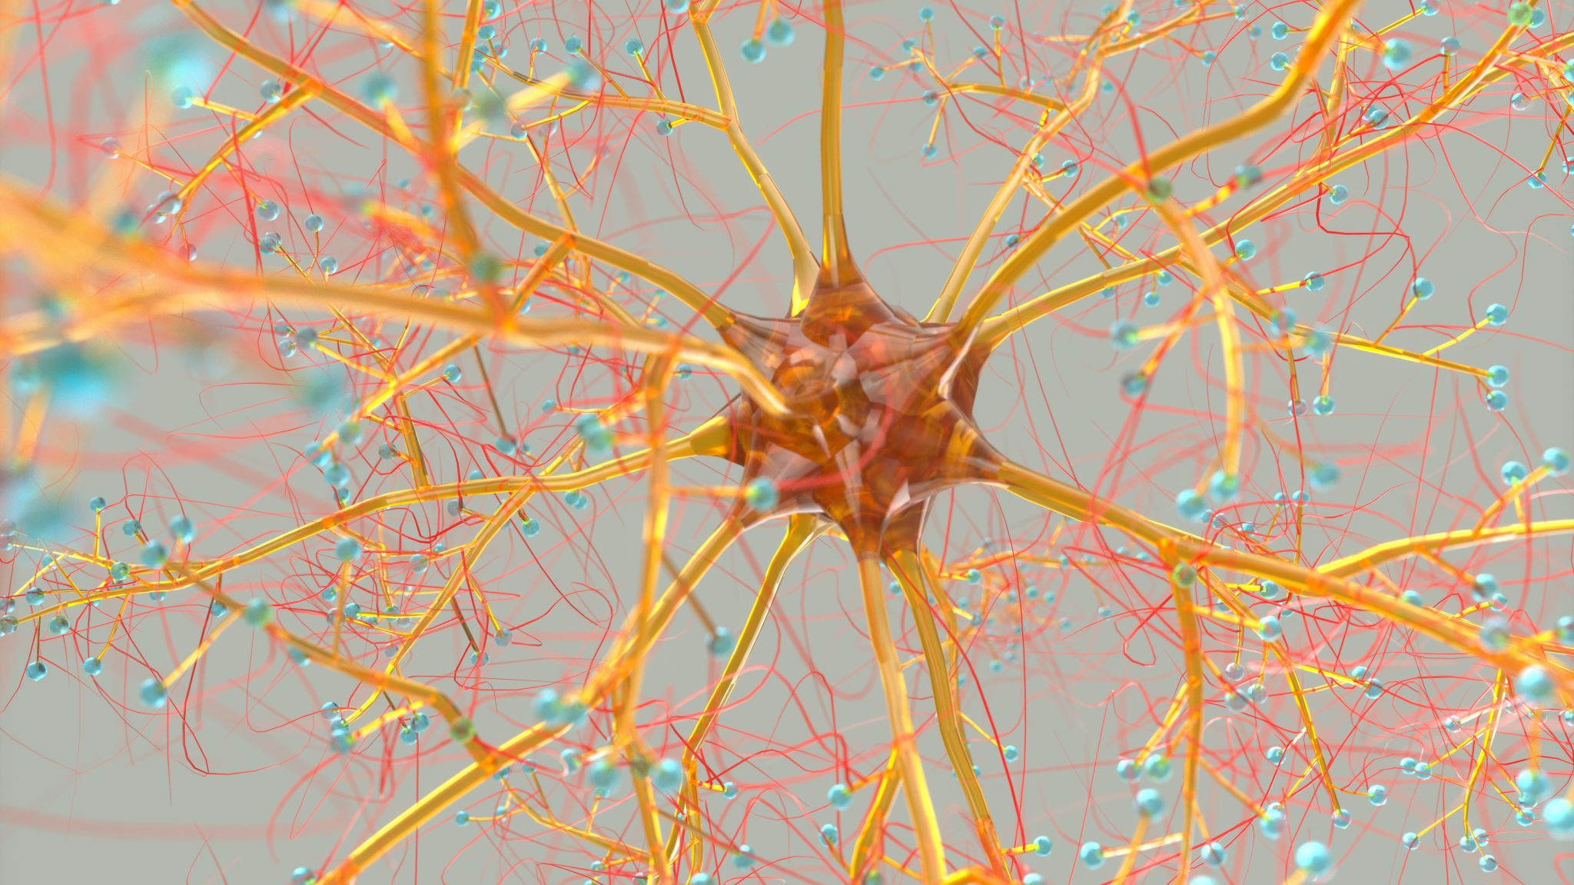
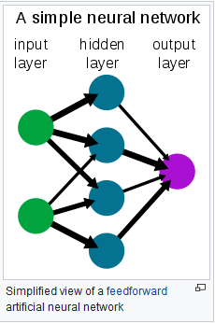
Artificial Neural Networks (ANN)
In machine learning and cognitive science ANNs are a family of statistical learning models inspired by biological neural networks.

Slide 2

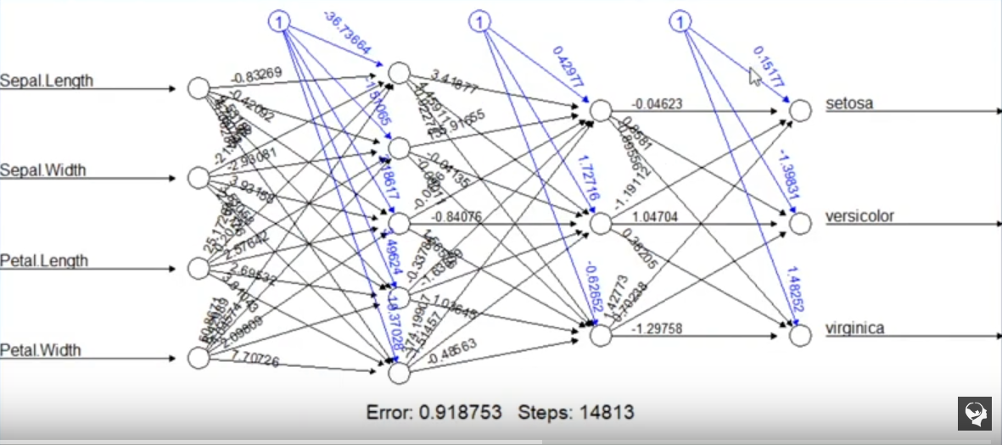
Bias
Weight
Input Nodes
Hidden Layer
Output Nodes
Neural networks rely on training data to learn and improve accuracy over time.
One of the most well-known neural networks is Google’s search algorithm.

Slide 3
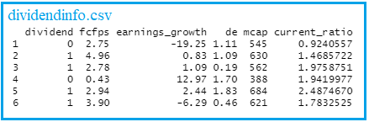

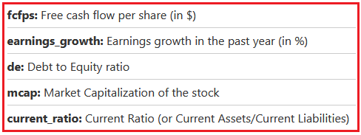


Slide 4
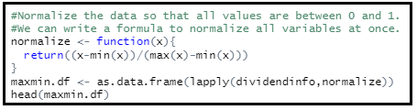
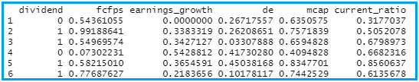
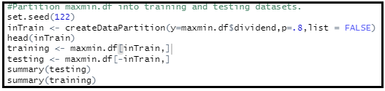

Slide 5

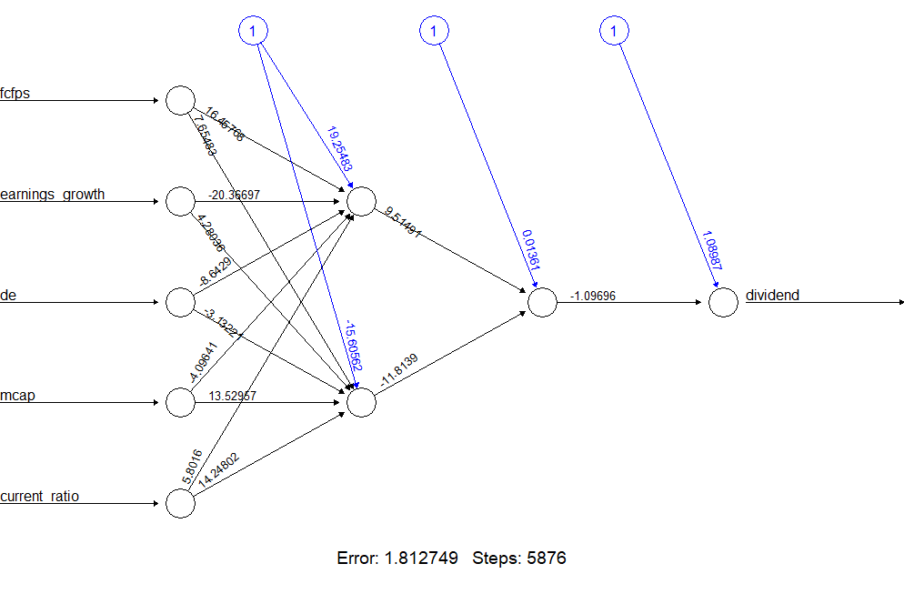
Default settings
1
2

Slide 6



Slide 7

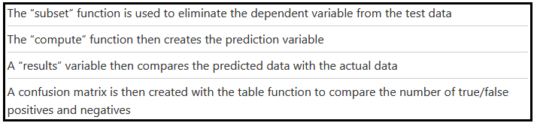
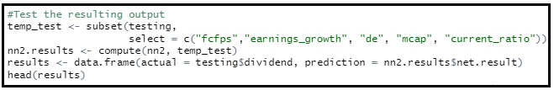
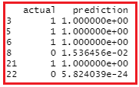
Classification correct for these 6 results

Slide 8
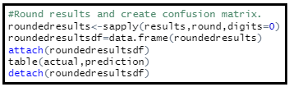


5% error rate
Last example showed how to use neural networks for classification.
Neural networks can also solve regression problems!

Slide 9
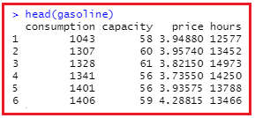
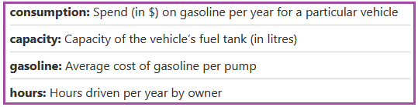
Target
Explanatory variables

Slide 10
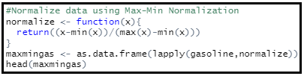
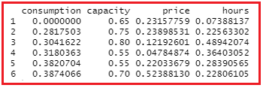
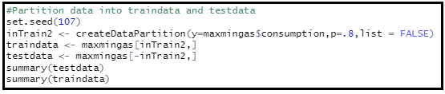


Slide 11
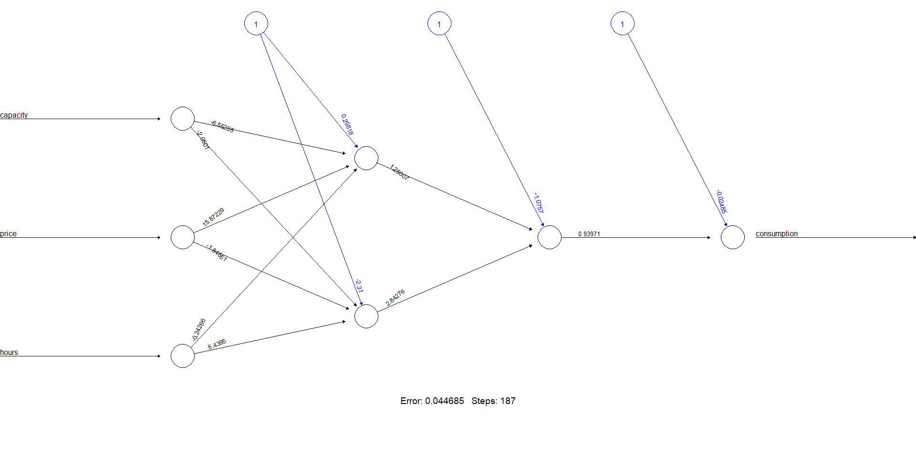

Slide 12

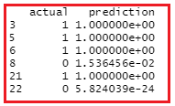
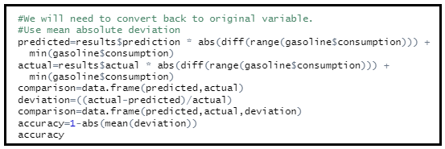


Slide 13
How does this black box work?

Slide 14
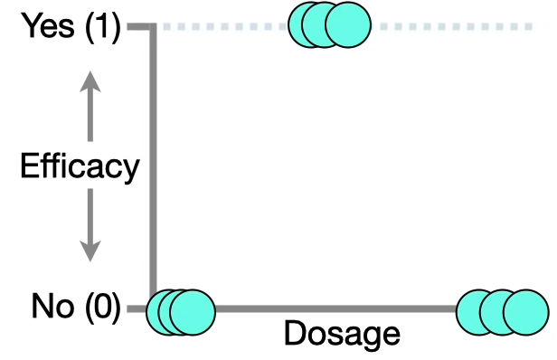
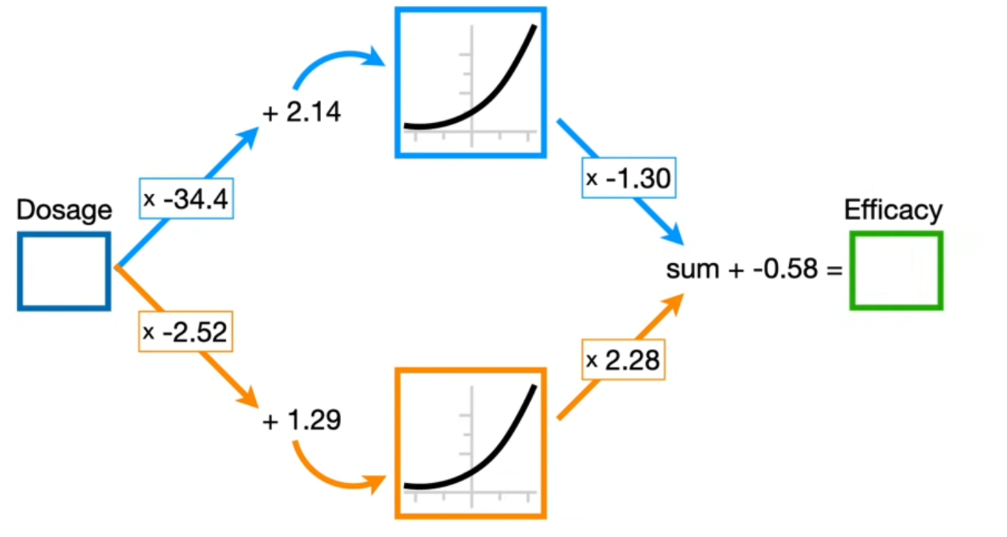
https://www.youtube.com/watch?v=CqOfi41LfDw
Neural Networks Part O: Inside the black box!!!
Tested drug designed
to treat an illness.
Given the data, we
would like to predict
whether or not a future
dosage will be effective.

Slide 15
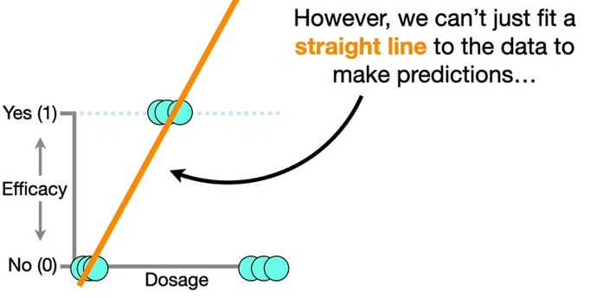
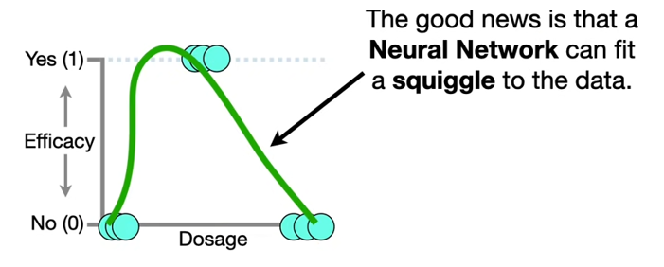
Going back to the data

Slide 16
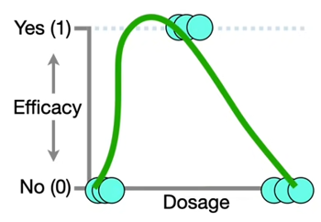
Nodes
Connections
Weights
Biases
The numbers along each connection represent parameter values that were
estimated when the Neural Network was fit to the data using Backpropagation.
For now, assume that we have already fit this Neural Network to this specific dataset and
we see the parameter estimates above.

Slide 17
Notice nodes in the hidden layer have curves inside.
These curves are the building blocks for fitting a squiggle to data.
Goal: To show how these identical curves can be reshaped by the parameter estimates and added
together to get the green squiggle that fits the data.

Slide 18
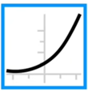
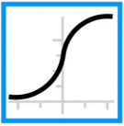
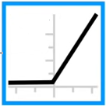
Can choose from a variety of curves
Softplus
These curves are called
Activation Functions
When you build a Neural Network,
you have to decide which Activation
Function or Functions you want to use.
Sigmoid
Rectified Linear Unit
(ReLU)

Slide 19
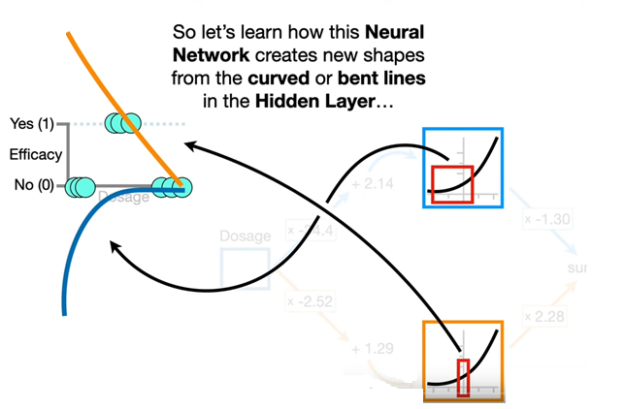
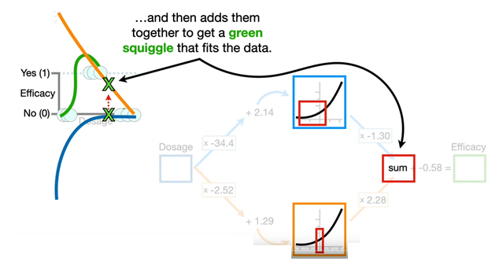
How does the Neural Network create new shapes from the Activation Functions?

Slide 20
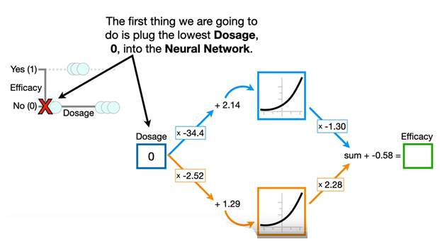
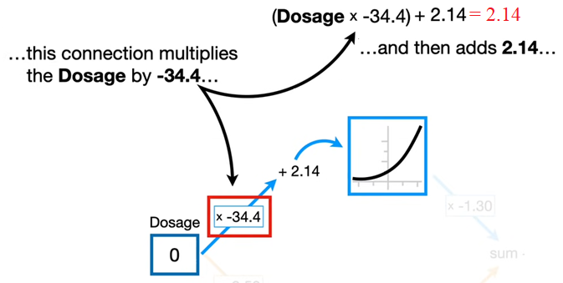
x-axis
coordinate
Plug into Activation
Function to get y-value

Slide 21
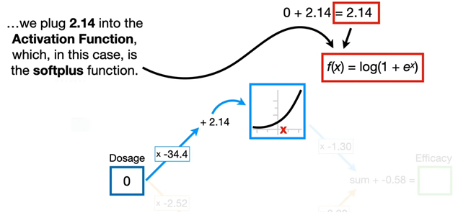

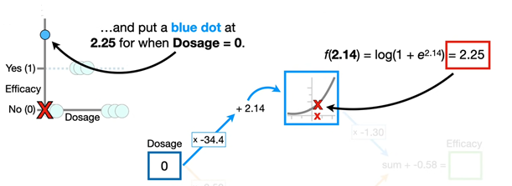
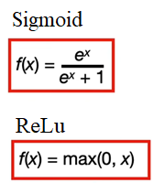
Keep in mind
this is ln().

Slide 22
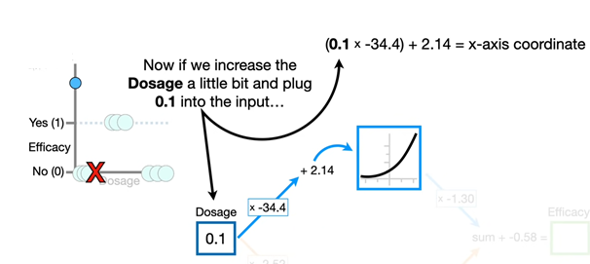
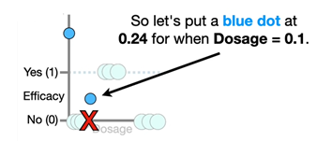
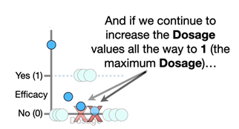

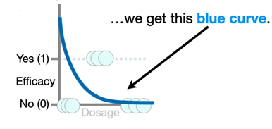
=-1.3

Slide 23
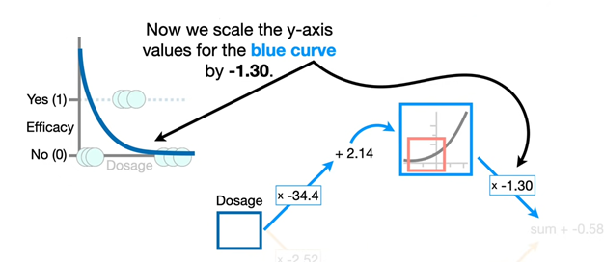
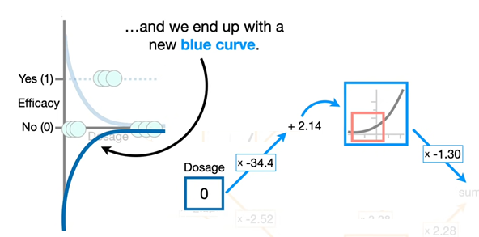
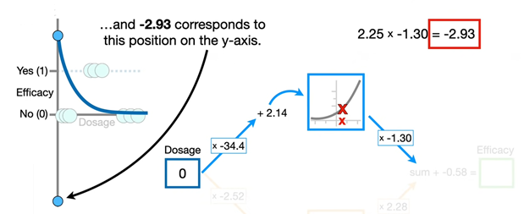

Slide 24
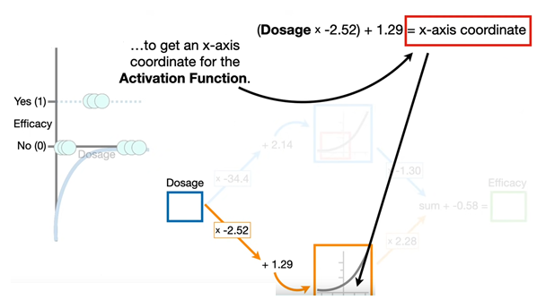
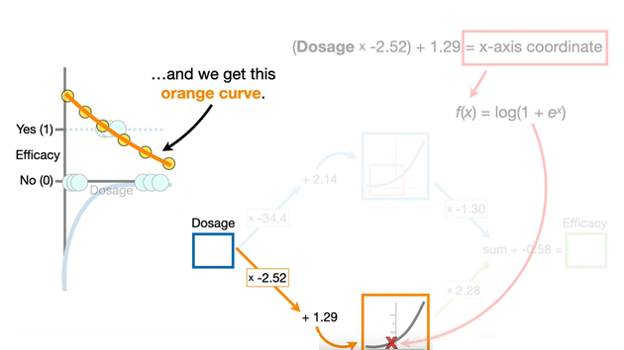

Slide 25
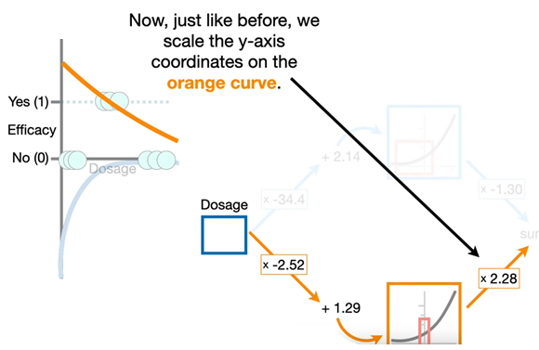
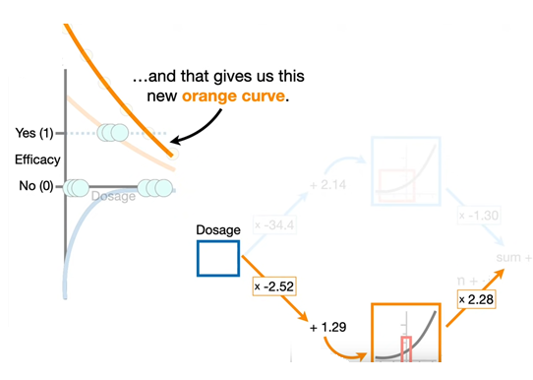

Slide 26
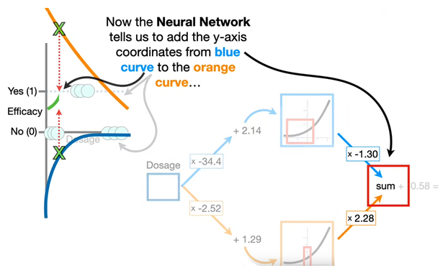
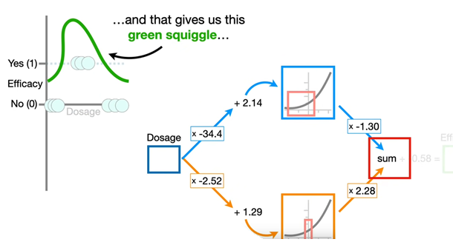

Slide 27
